Slide 1
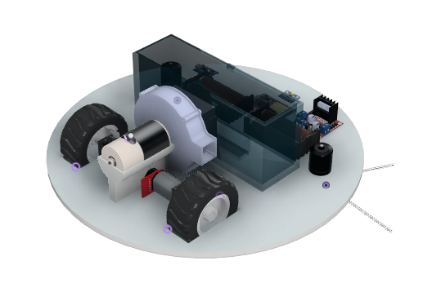
TEAM
TECHKNIGHT’S ALLIANCE
IIT MADRAS
Multi-agent Coverage Planning System
KIRTAN PATEL
KAHAN LAKHANI
NISHARG MANVAR
HARISH R
DHRUV MAROO

Slide 2
Mechanical Design
01
Electronics Design
02
TABLE OF CONTENTS
The DARP Algorithm
03
Mapping and Planning
04
Deployment Strategy
05
Manufacturability
Serviceability
Failure Analysis
Manufacturability
Serviceability
Failure Analysis
Working of the Algorithm
Failure Cases
Failure Resolution
Template Based Algorithm
Epsilon Star Algorithm
Final Robot Paths
Cleaning Efficiency
How to get 5 bots to work efficiently with Mapping and Planning

Slide 3
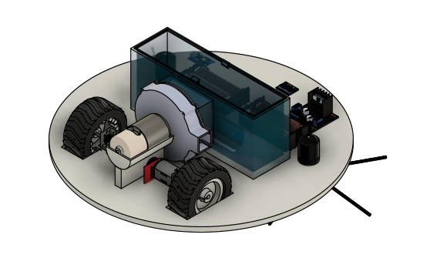
Mechanical Design

Slide 4
Ideation
SUBWAY STATIONS
The key factors taken into consideration while design the robot were:
Dimension Constraints
Cleaning Efficiency
Equipment Onboard
Electrical equipment
Cleaning equipment
Mobility
Taking into consideration the above factors, the robot was designed to be of a disk shape for better maneuvering with two rotating brushes on the sides for increasing cleaning area and efficiency.The wheel placement was decided by triangulation method to provide more room at the front for a higher sweeping area for the brushes.
Jupiter is a gas giant and the biggest planet in our Solar System. It’s the fourth-brightest object in the sky
Yes, Saturn is the ringed one. This planet is a gas giant, and it’s composed mostly of hydrogen and helium

Slide 5
Manufacturability
SUBWAY STATIONS
Body and Bin
The material being used for the body and the bin of the robot is ABS (Acrylonitrile butadiene styrene). ABS is widely used for the following reasons:
Its cheap
Easy to manufacture
Can injection molded
Brushes
The brushes are an integral part of the robot and play an important role in cleaning. They need to be very strong as they are needed to rotate at very high RPM but at the same time flexible enough to scrape the floor efficiently and also not hinder in the mobility of the robot. The brushes used are of nylon to provide necessary strength and flexibility.
Jupiter is a gas giant and the biggest planet in our Solar System. It’s the fourth-brightest object in the sky
Yes, Saturn is the ringed one. This planet is a gas giant, and it’s composed mostly of hydrogen and helium

Slide 6
Serviceability
Since we expect the robot to function in a dirty environment, the mechanical parts used need regular maintenance for optimum performance and need to be replaced after a certain period of time.
Jupiter is a gas giant and the biggest planet in our Solar System. It’s the fourth-brightest object in the sky
PART | CLEANING FREQUENCY | REPLACEMENT FREQUENCY
BIN | AFTER EVERY USE | –
BRUSHES | AFTER EVERY 5 USES | AFTER 180 USES
FILTER | AFTER EVERY 5 USES | AFTER 50 USES
FRONT CASTER WHEEL | AFTER EVERY 10 USES | –

Slide 7
Failure Cases
Material Failure
The body has been designed with an appropriate quantity of ABS plastic to handle the weight of the components and the high torques developed.
Contamination
Vacuum fan
Motors
Electrical components
Re-dispositon

Slide 8
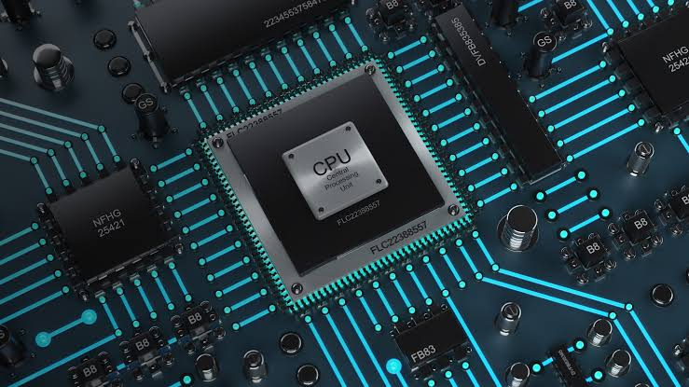
Electronics Design

Slide 9
Sensors
IMU
Component chosen : MPU6050
Purpose : To get the accurate position as well as orientation of the bot at all times
LIDAR
Component chosen : TF-LUNA Micro LiDAR
Purpose : to map and understand the environment around the bot
Microcontroller
Component chosen : ESP32 WROOM board
Purpose : To obtain all the sensor data and publish to the ros core running on the local machine and give instructions to the motors and controllers.

Slide 10
Electronics and Power
BATTERY PACK
A battery pack consisting of 4 LG HG-2 18650 3000 mAh Li-ion batteries
Aspects considered :
Energy density
Should last long enough for one clean without having to recharge in middle
Minimum calendar ageing
MOTORS
DC Gear Motor
Component Chosen : RS-540SH-5045
Purpose : To drive the wheels
DC Motor - Fan
Component Chosen : 12V - 3000 RPM DC
Purpose : to run the vacuum fan
Jupiter is a gas giant and the biggest planet in our Solar System. It’s the fourth-brightest object in the sky

Slide 11
Manufacturability
Component | Manufacturer | Procurement in India | Component Testing
MPU 6050 | InvenSense | Mouser Electronics | Basic Calibration (using Adafruit Library)
TF-LUNA Micro LiDAR | Benewake | Robu.in | Elementary software testing (using the Serial library)
ESP32 WROOM board | Espressif | Robu.in | Unit tests (using the ESP-IDF)
LG HG2 18650 Cells | LG | Battery Bro | Capacity tests and CCD tests
DC Motors | Kysan Electronics | Kysan Electronics | Direct testing to find temperature and efficiency

Slide 12
Failure Modes and Effects Analysis (FEMA)
Damaged Sensors
CAUSE : The IMU and Lidar might get damaged due to constant exposure to water and other fluids.
EFFECT : Decrement in accuracy and total non-working in case of severe damage
DETECTION : Unusual performance
ACTION : If one sensor is damaged, the sensor fusion algorithm detects a significant amount of discrepancy in the values obtained from two sensors.
Erroneous Navigation
CAUSE : The cumulative errors in the position of the bot leads to a significant deviation from the intended path
EFFECT : Fallacious values being fed into the path planning algorithm further reducing the efficiency of bot
ACTION : The following solutions are proposed :
Implementation of an Extended Kalman filter algorithm to fuse the sensor data obtained from inertial measurement unit and LIDAR. ( Can be achieved via ROS Packages)
Setting up a Proportional-Integral-Derivative controller in the navigation ROS stack to fine tune the control.

Slide 13
Failure Modes and Effects Analysis (FEMA)
Abnormal Temperature
CAUSE : Due to overload and continuous operations, the Lithium batteries might get over-discharged
EFFECT : Significant risk of abnormal temperatures and the batteries getting exploded
DETECTION : The internal temperature sensors monitor the temperature of the batteries and the system continuously
ACTION : The battery pack comes with a BMS which should handle this case forcing a shutdown of the power circuit. Further to prevent reaching abnormal temperatures, a proper ventilation system is considered while designing the model.

Slide 14
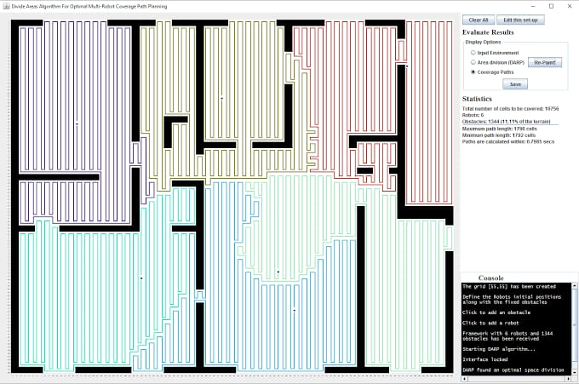
The DARP Algorithm

Slide 15
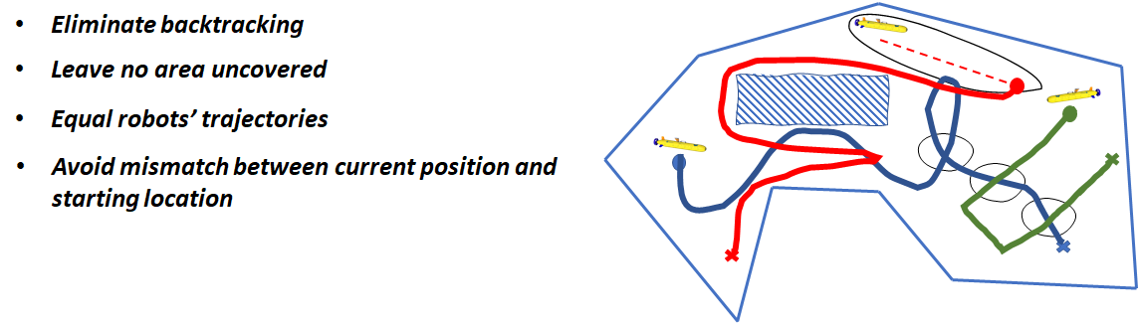
DARP Working
Objective:
Design robot paths that completely cover this area of interest in the minimum possible time called coverage path planning problem (CPP).

Slide 16
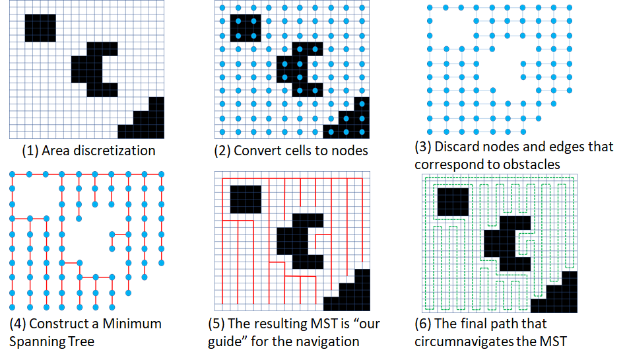
Basic Building Blocks
Cellular decomposition
Spanning tree coverage (STC)

Slide 17
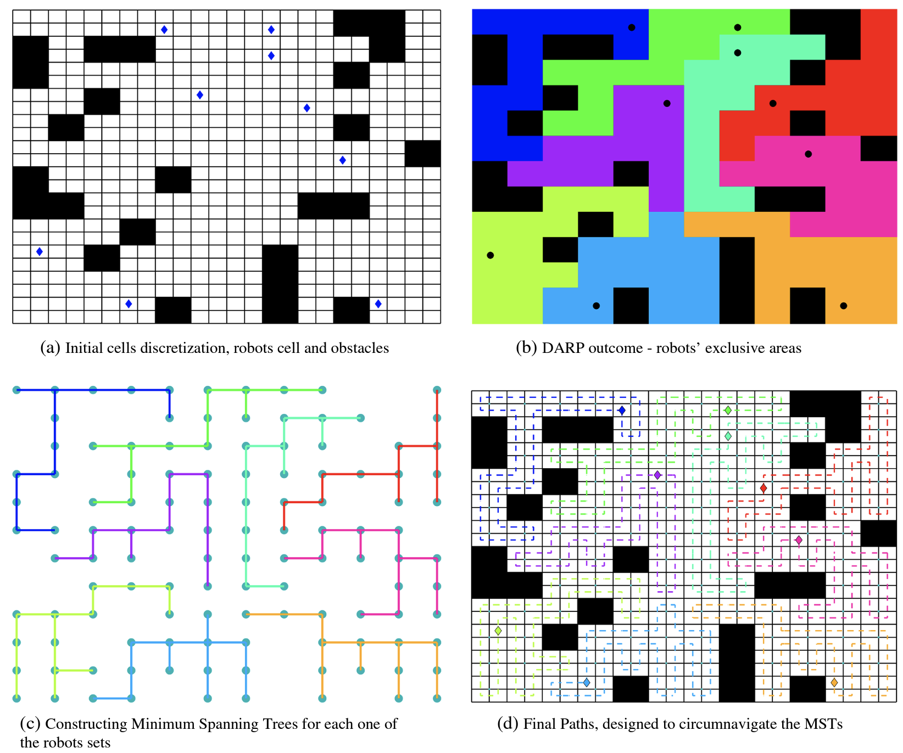
mCPP (multiple CPP)
So, the main idea of DARP (Divide Areas based on Robot’s Initial Positions) is to apply STC individually for each robot by first assigning a certain area of the map to each robot.

Slide 18
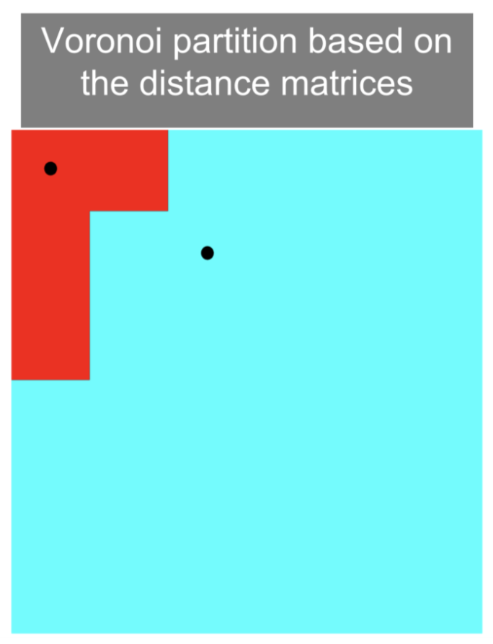
How to assign regions ?
The most natural way seems to use the idea of Voronoi partitioning, i.e. assign a block to the robot with the closest initial position.
We again run into the problem where the area
that each bot covers becomes dependent on the initial position of each bot.

Slide 19
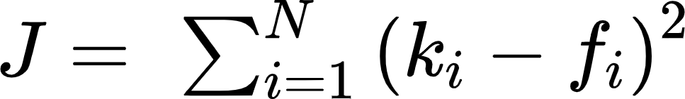
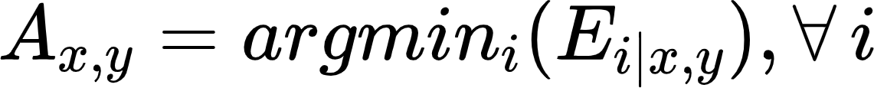
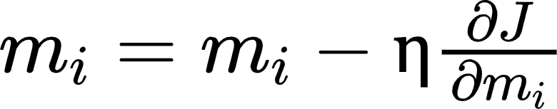
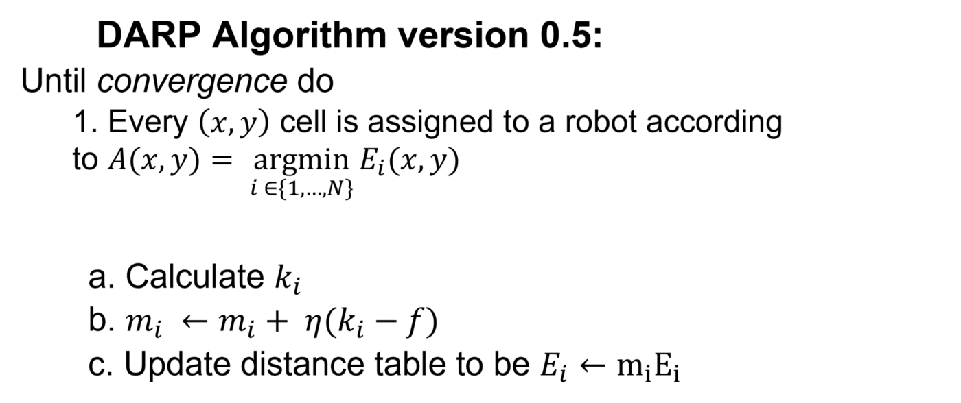

DARP 0.5
For every ith operational robot, an evaluation matrix Ei is maintained. This evaluation matrix Ei expresses the level of reachability (e.g. distance) between the cells of L (the map) and ith robot’s initial position xi(t0).
The DARP algorithm’s core idea is that each evaluation matrix Ei can be appropriately “corrected” by a term mi as follows:
Error function
Where ki denotes the number of assigned cells to the ith robot, while fi denotes the number of cells that the ith bot has to cover.

Slide 20
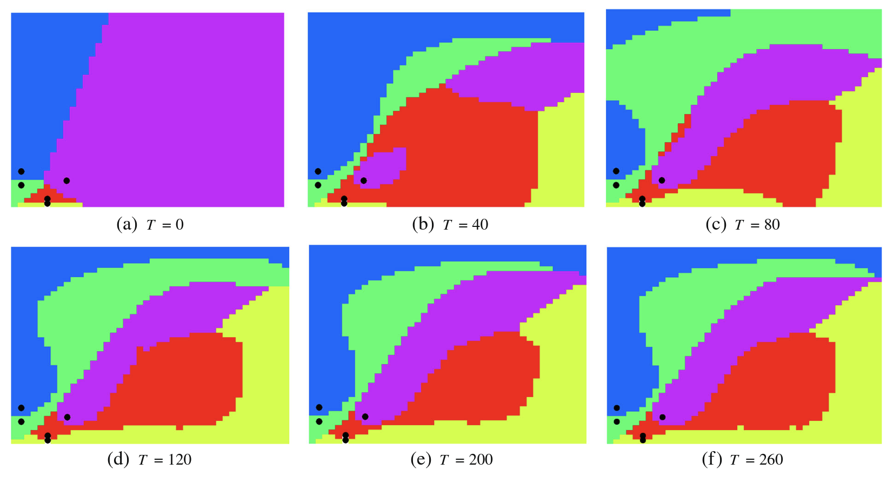
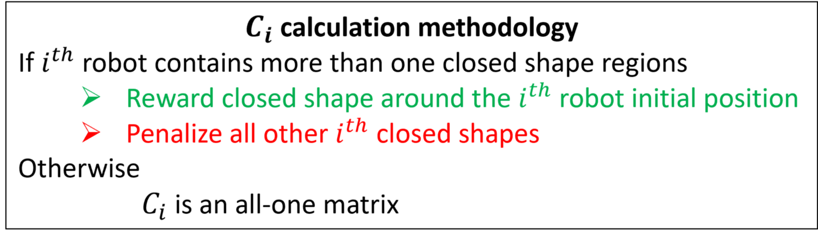
DARP 1.0
Spatial Disconnectivity problem:
To tackle this issue, an extra connectivity matrix is introduced.
Jupiter is a gas giant and the biggest planet in our Solar System. It’s the fourth-brightest object in the sky

Slide 21
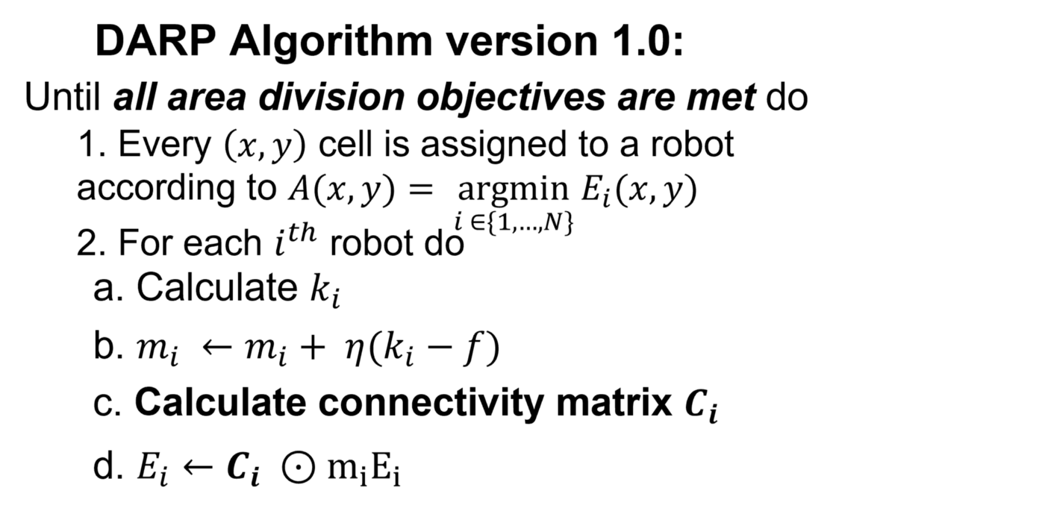

Slide 22
DARP Failure Analysis
Failure of algorithm to converge due to close initial position of robots.
To tackle this problem we introduced a filter in the sense that only if all pairs of robots were separated a constant minimum distance will we try and find the optimal path using DARP.
In some other cases, even though the bots were far spaced, the algorithm was unable to converge.
If we give some leeway in terms of area covered by each bot the algorithm is able to converge.
Jupiter is a gas giant and the biggest planet in our Solar System. It’s the fourth-brightest object in the sky

Slide 23
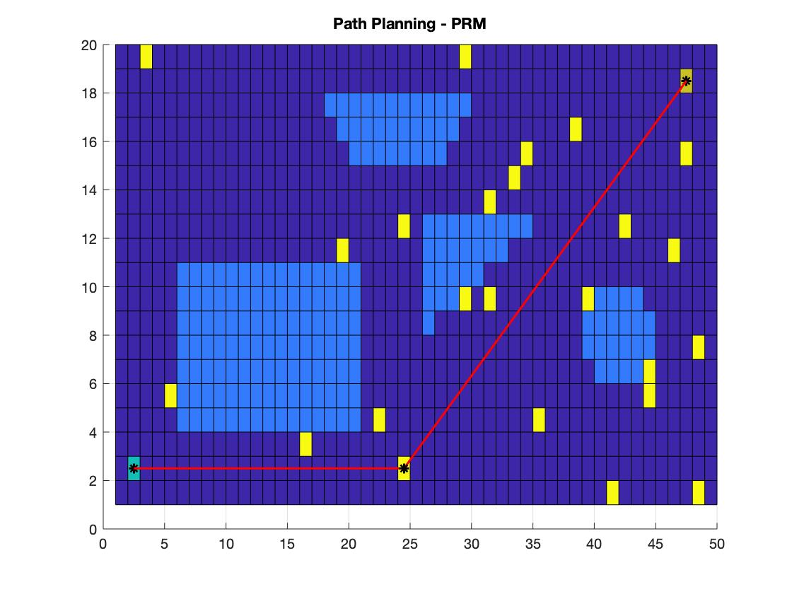
Mapping and Planning

Slide 24
Mapping and Planning
With Mapping being introduced in the problem, the base problem changes from an offline path planning problem to an online path planning problem.
In offline mode, the path planning task starts from a point where the agent has a complete knowledge about: its environment with obstacles (The complete map is given), its initial position, and its final goal within this environment. In online mode, path planning is carried out in parallel while (a) moving towards the goal, and (b) perceiving the environment including its changes.
For Online Complete Coverage Planning, we can use either of the 2 established algorithms.
Template Based Methodology
Epsilon star
Jupiter is a gas giant and the biggest planet in our Solar System. It’s the fourth-brightest object in the sky

Slide 25
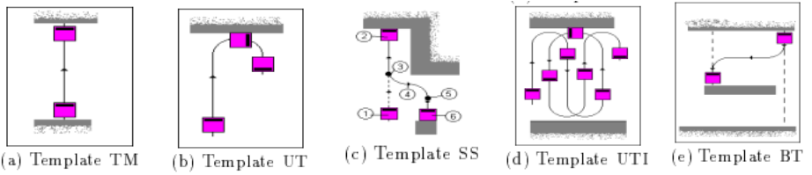
Template Based Algorithms
This system, when implemented on a commercially available mobile platform, exclusively relies on odometry and ultrasonic data, aiming at providing low-cost navigation modules that could be implemented.
The complete coverage trajectory is planned as a sequence of predefined trajectories denoted as templates along the lines proposed. A set of 5 templates is proposed as the minimum number to achieve a satisfactory oor coverage of an area which contains obstacles in its interior. Wall tracking is also used.

Slide 26
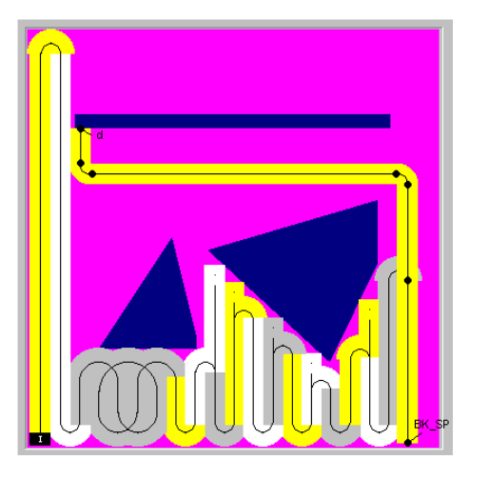
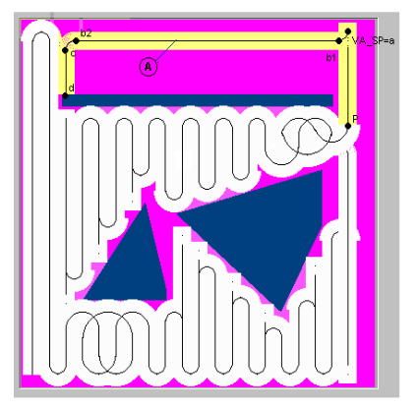
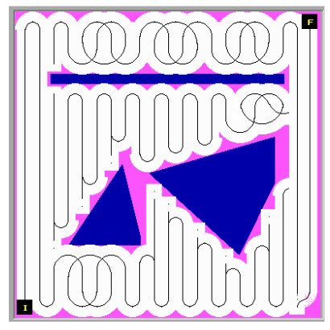
Final Robot Paths

Slide 27
Epsilon Star
The Epsilon Star Algorithm works on a grid based approach.
The algorithm is built upon the concept of an Exploratory Turing Machine (ETM) which acts as a supervisor to the autonomous vehicle to guide it with adaptive navigation commands. The ETM generates a coverage path online using Multiscale Adaptive Potential Surfaces (MAPS).
The Epsilon Star Algorithm can be understood as :
Dividing Coverage Area into Tiles
Dynamically Constructing Multi-scale Potential Surfaces (MAPS)
Supervisory Control Structure of the execution
Completing the task with no cells left to unattended on a global level.
This means that a global extrema has been reached

Slide 28
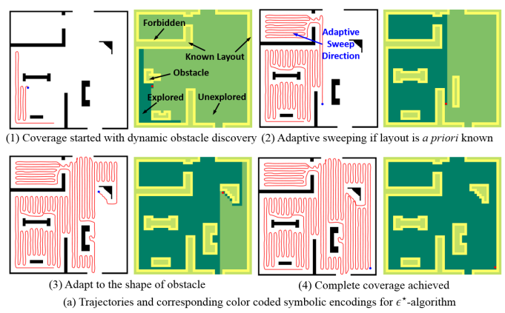
Final Robot Path

Slide 29
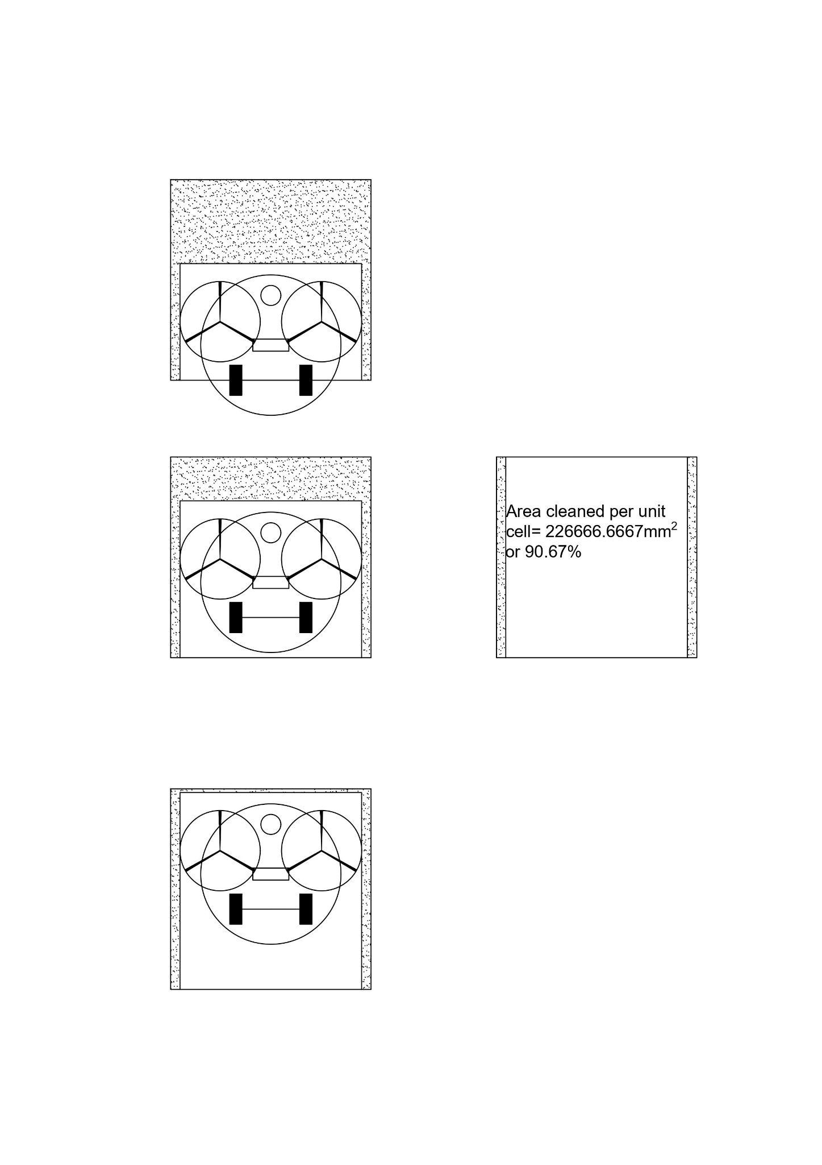
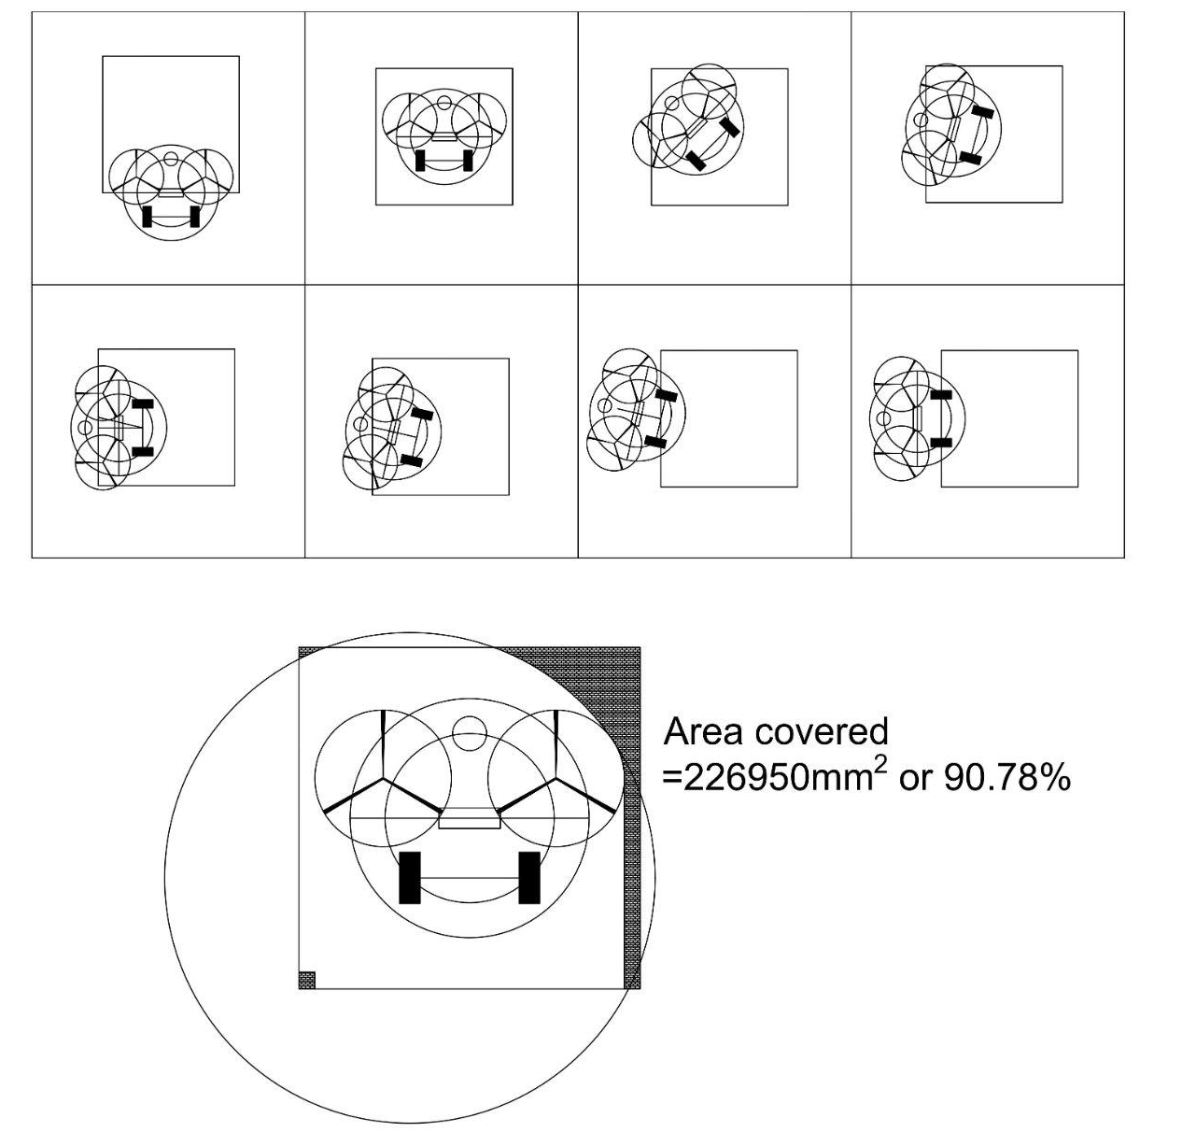
Cleaning Efficiency
Coverage depends on the value of the orientation of the obstacle and epsilon. For grid obstacles and Smaller epsilon, we can achieve a cleaning efficiency of more than 90%. Having said that, since we are using Online Path Planning, the exact cleaning efficiency varies from map to map.
From Round 1 Report, it is clear that the bot covers the grid cell with more than 90% efficiency and hence any complete coverage algorithm used with the bot would give a cleaning efficiency of more than 90%.
Furthermore, with smaller and smaller values of epsilon and wall tracking, the cleaning efficiency is bound to go higher.

Slide 30

Deployment Strategy

Slide 31
1.Template Based Methodology
Deploying multiple bots in such a scenario can save the repetition of cleaned areas and the travel time from one point to another.
Back-tracking
We can evaluate the extent of backtracking and deploy a bot in order to avoid having to do that.
When a situation of extreme backtracking occurs, we can deploy another bot at the new place instead of having to backtrack.
Traveling
As seen in the Final Robot Path Example, in the latter part of the path in image 1, we can see that in order to resume it’s cleaning after having dealt with the obstacles, the robot travels back to its intended position before encountering the obstacle.In case of large obstacles, this travel time can be significant. Thus as as soon as the obstacle crosses a certain threshold, a new bot can be instantly deployed at the intended position.
This can be carried out efficiently with 5 bots by cyclic allocation of intended positions.
For better efficiency, if more than one bots are idle, the bot nearest to it (path-distance, not euclidean), will be assigned to travel to that position and continue the cleaning.

Slide 32
2. Epsilon Star
In any Template based Algorithm, there might be back-tracking and the need for the robot to go back to another location (for complete coverage).
Deploying multiple bots in such a scenario can save the repetition of cleaned areas and the travel time from one point to another.
Using the same approach as above, we can keep the idle robots on stand by and deploy them into the map when needed.
Jupiter is a gas giant and the biggest planet in our Solar System. It’s the fourth-brightest object in the sky

Slide 33
Thank You!
Open to Questions

